Slide 1

QCELS for QAGC
Connor Lenihan,
Avner Bensoussan,
Elena Chachkarova,
Karine Even-Mendoza,
Sophie Fortz
King’s College London

Slide 2
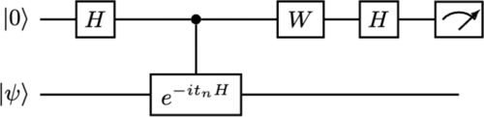
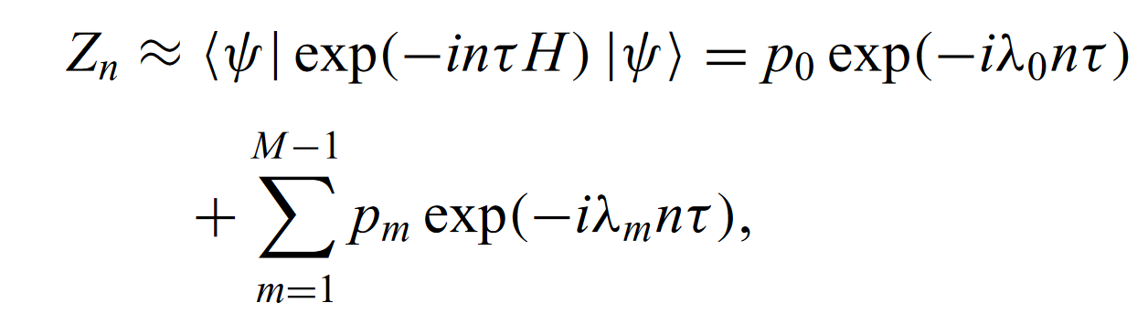
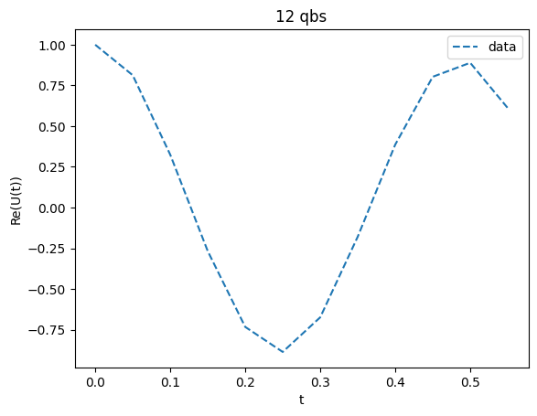
Collect Data
Trotter-Suzuki
Hadamard Test
Hartree-Fock reference
Even Shorter Quantum Circuit for Phase Estimation on Early Fault-Tolerant Quantum Computers with Applications to Ground-State Energy Estimation – Ding, Lin 2023

Slide 3
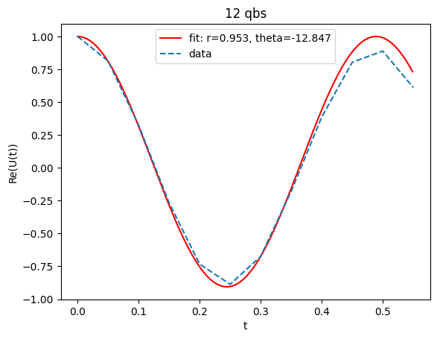
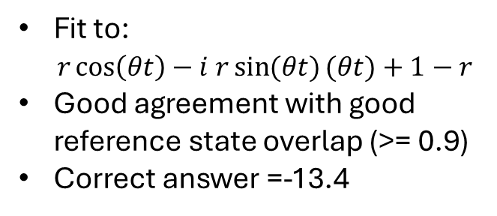
Fitting – 12qbs
Fit to:
$r\cos\left(θt\right)−i r\sin{(θt)}(θt)+1−r$
Good agreement with good reference state overlap (>= 0.9)
Correct answer =-13.4

Slide 4
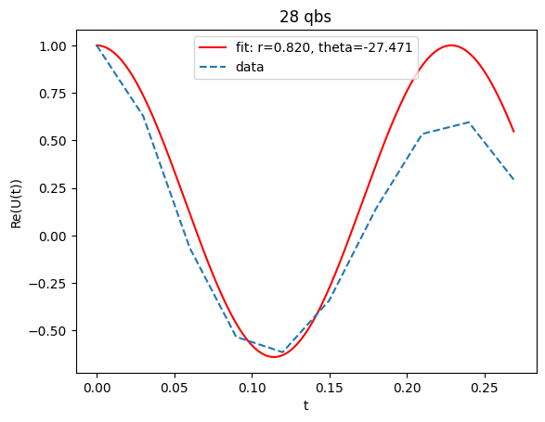
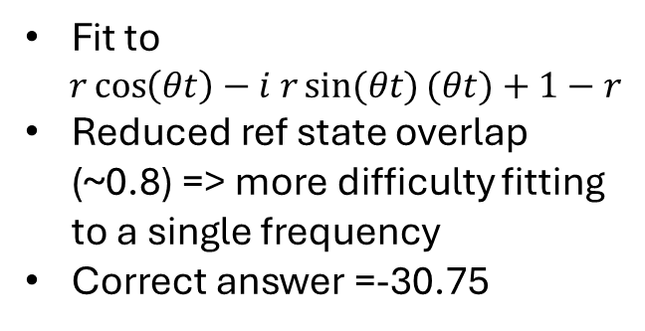
Fitting - 28 qbs
Fit to
$r\cos\left(θt\right)−i r\sin{(θt)}(θt)+1−r$
Reduced ref state overlap (~0.8) => more difficulty fitting to a single frequency
Correct answer =-30.75

Slide 5
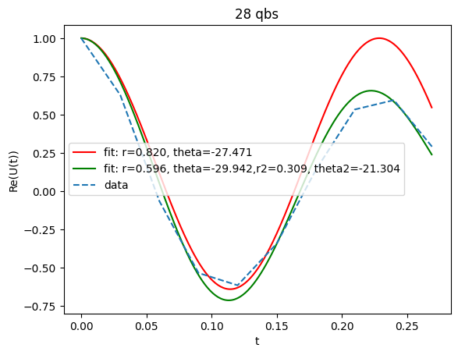
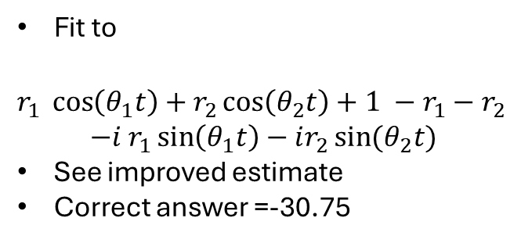
Fitting 2 frequencies
Fit to
$r_{1}\cos\left(θ_{1}t\right)+r_{2}\cos\left(θ_{2}t\right)+1 −r_{1}−r_{2}$
$$−i r_{1}\sin\left(θ_{1}t\right)−ir_{2}\sin{(θ_{2}t)}$$
See improved estimate
Correct answer =-30.75

Slide 6
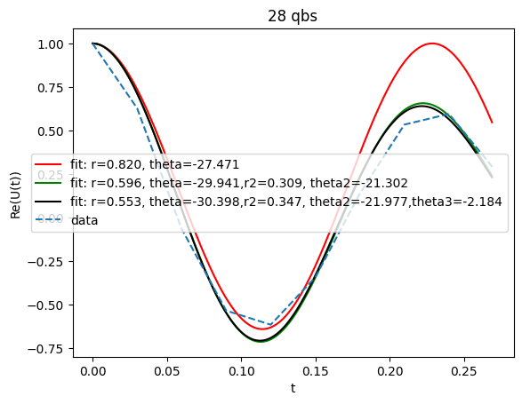
Or more…
Correct answer =-30.75

Slide 7
Improvements
Limitations:
Running with truncated Hamiltonian and 1st order Trotter to reduce gate depth
MPS simulator – cuts off long range entanglement
HF state has lower overlap for larger systems
Improvements:
More points means can fit more frequencies, but fit can be unstable
2nd + order Trotter? … increases depth
Improved reference state? … Adapt QSCI?

